Slide 1
Welcome
Sign In

Slide 2
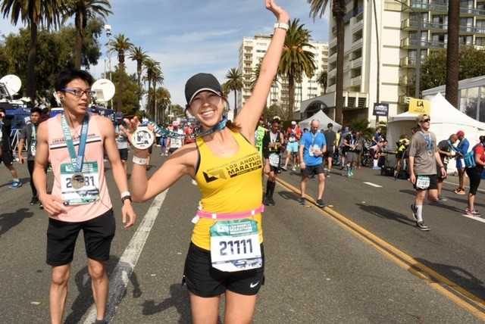
Mrs. Lozick
8th year teaching - 6th at JMS
BA - UC Berkeley:
Environmental Economics and Policy
Legal Studies
MA - Cal State LA
Mathematics Education
Single Subject Teaching Credential - Cal State LA
Runner/Cyclist/Foodie

Slide 3
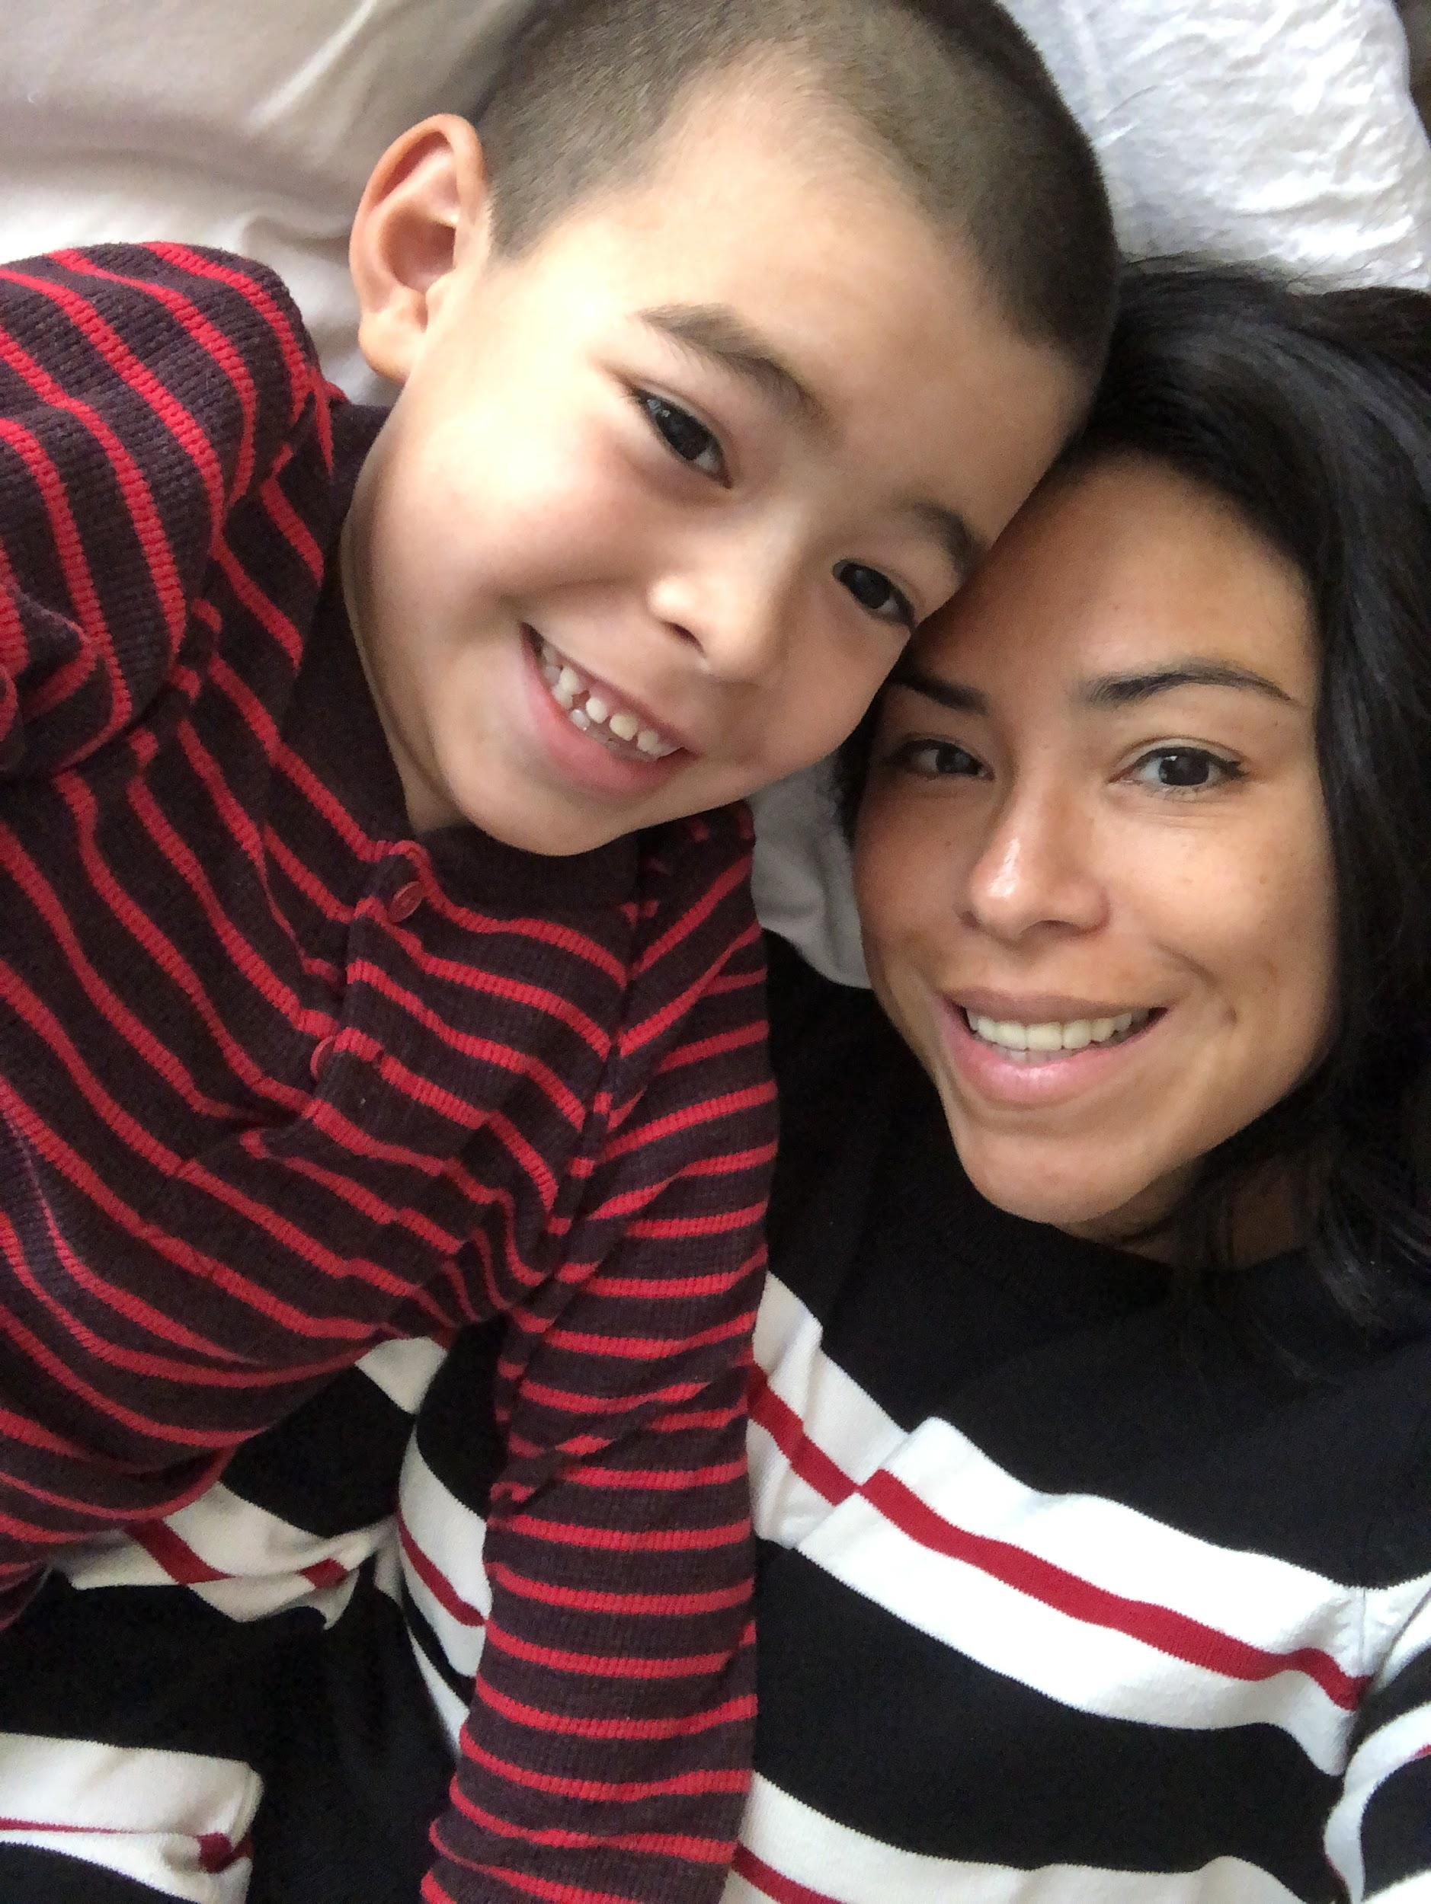
Ms. Wampler
3rd year teaching at JMS
BS-Psychology
  CSUN
Education Specialist Teaching Credential
  Point Loma Nazarene University
Mom/Lego Builder/Cheese Lover

Slide 4
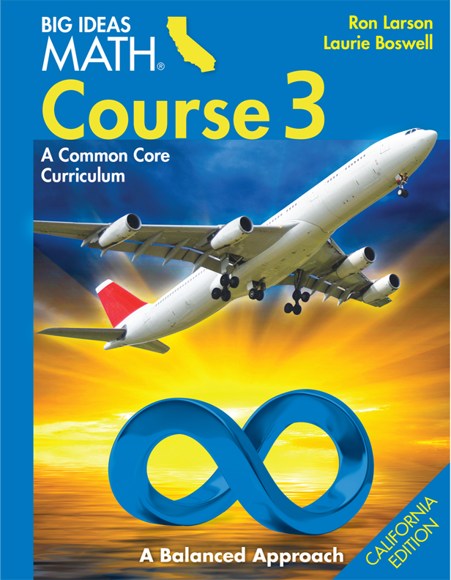
MATH 8
Units
THE NUMBER SYSTEM
EXPRESSIONS & EQUATIONS
FUNCTIONS
GEOMETRY
STATISTICS & PROBABILITY
1
2
3
4
5

Slide 5

ALGEBRA 1
Units
PATTERNS/ALGEBRAIC THINKING
DATA ANALYSIS/PREDICTION
MEASUREMENT
GEOMETRIC CONCEPTS
NUMBER SENSE
1
2
3
4
5

Slide 6

GEOMETRY
Units
PROOFS
CONGRUENCY
SIMILARITY
TRIGONOMETRIC FUNCTIONS
EUCLIDEAN GEOMETRY
1
2
3
4
5

Slide 7
Classroom Expectations
Come to class prepared with your binder, planner, notebooks, writing utensils, supplies, questions and ideas to class each day.
Arrive promptly. Your ideas are important, and we desire to hear them and help them grow. We can’t share your ideas if you are not present.

Slide 8
Classroom Expectations
Be kind or neutral to everyone. Be patient with yourself and others, your classmates, your teacher and your classroom. Contribute to the community in a positive and uplifting manner.
Assignments will be due at the beginning of class. If it is not turned in, it will be considered late.

Slide 9
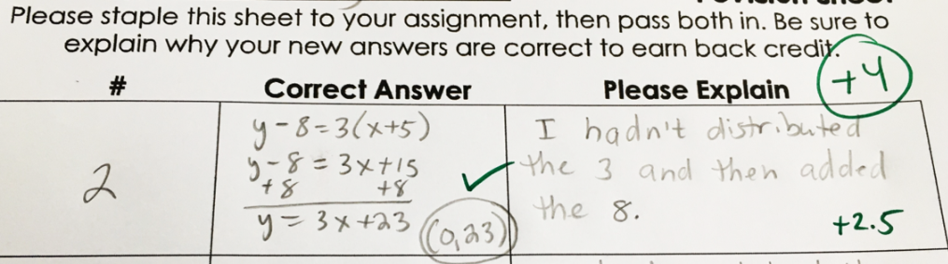
Quiz Corrections
Score below 90%
Correction form MUST include re-worked out steps AND explanation of original mistake utilizing academic vocabulary

Slide 10
If you aren’t willing to work for it, don’t complain about not having it

Slide 11
I haven’t failed, I’ve just found 10,000 ways that don’t work

Slide 12
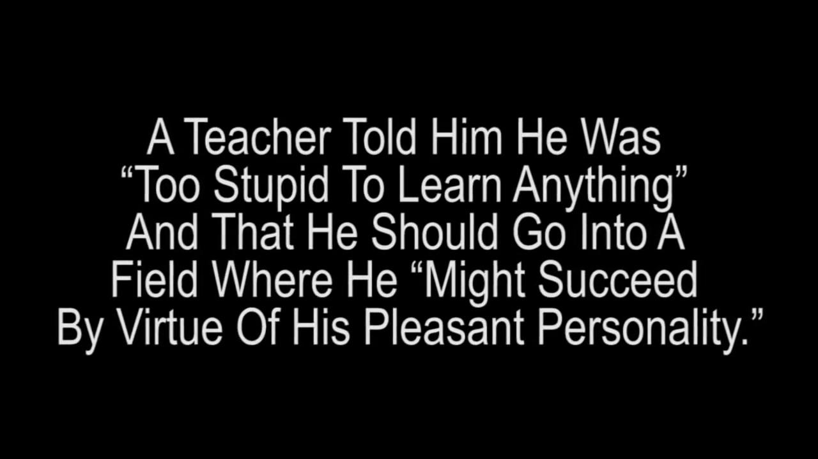

Slide 13
If you’ve
NEVER FAILED you’ve
NEVER TRIED anything new

Slide 14
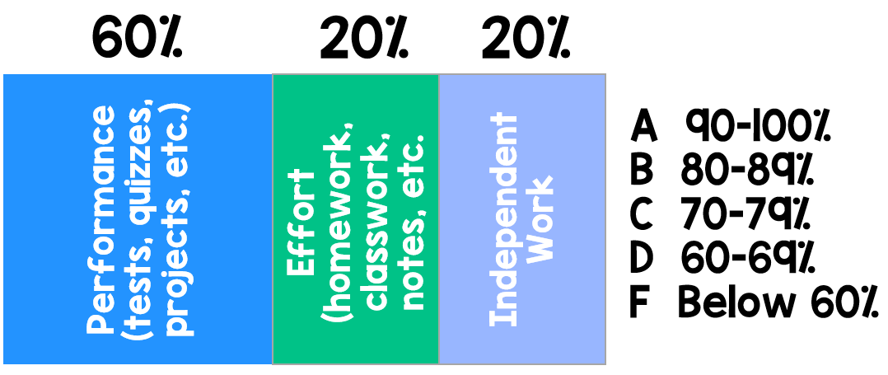
Class Grading Scale
Performance: 60%
Tests
Quizzes
Projects
Performance tasks
Effort: 20%
Homework
Classwork
Notebook check
Independent Work: 20%

Slide 15
If you have any questions
Please email
lozick_s@sgusd.net
wampler_d@sgusd.net

